Slide 1
xRAG: Extreme Context Compression for Retrieval-augmented Generation with One Token

Slide 2
Issuses
Retrieve many documents using RAG which makes number of input token large.
Conventional compressors like LongLLMLingua compress documents through deleting tokens
Train a new compressor for a new documents.

Slide 3
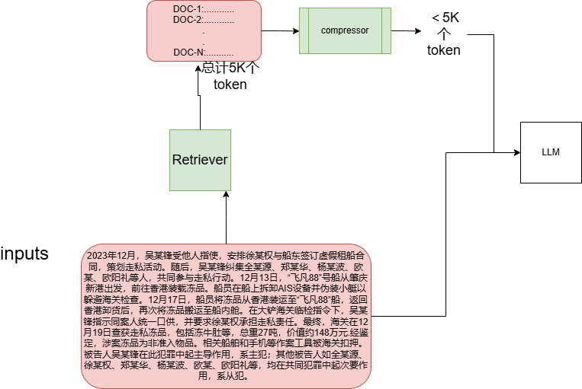
Target of compressor

Slide 4
Contributions
Post a new framework to compress the documents into ONE token.
Redefines the document embedding in dense retrieval
Computation cost is low! Only trainable component is two linear layers.

Slide 5
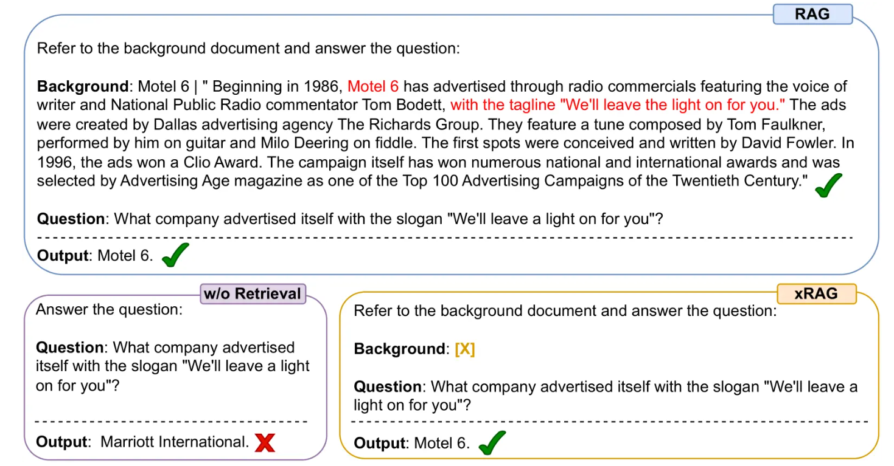
PureRAG V.S XRAG

Slide 6
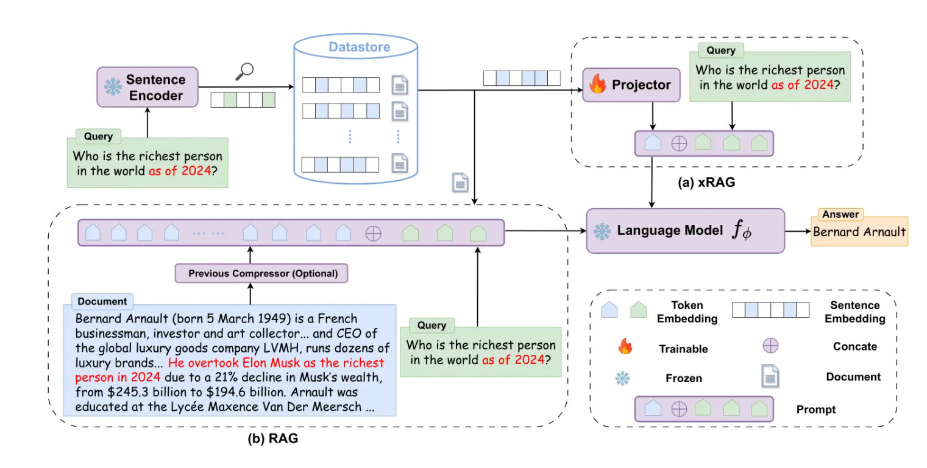
Principle of X-RAG

Slide 7
Features of X-RAG
Introduce modality fusion from multi-modality.
Different modality connects through the modality bridge in multi-modality field.
Use feature encoder to extract document features and then integrating them as features from the retrieval modality.

Slide 8
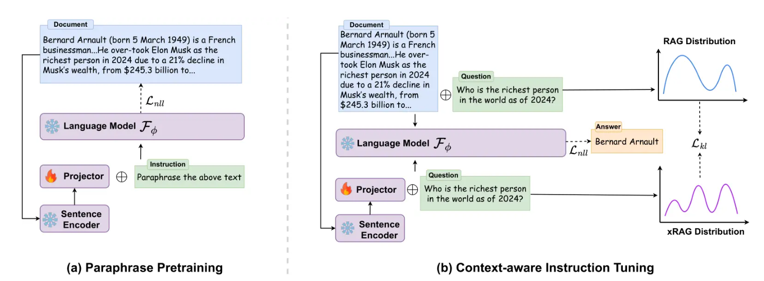
Train
[DOC] --→ [X]
[[101, 102020, 23213, 102],…..]压缩成一个token[101, 10002, 100002, 102]

Slide 9
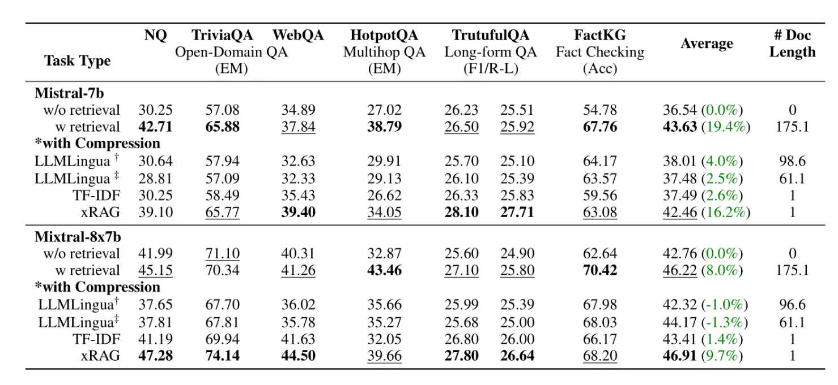
Result

Slide 10
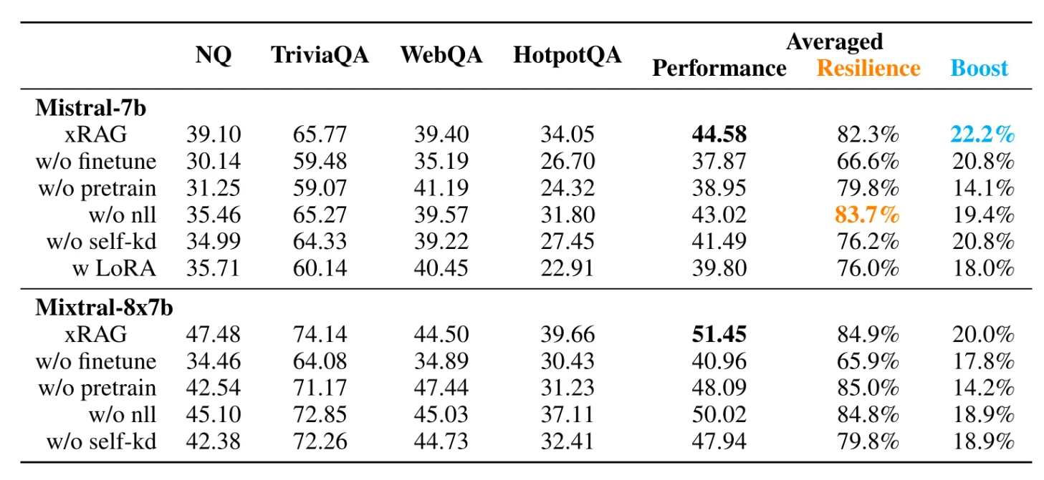
What makes X-RAG effective

